Slide 1

Sunrise Airline
Customer Experience Optimization
Skye Liu

Slide 2

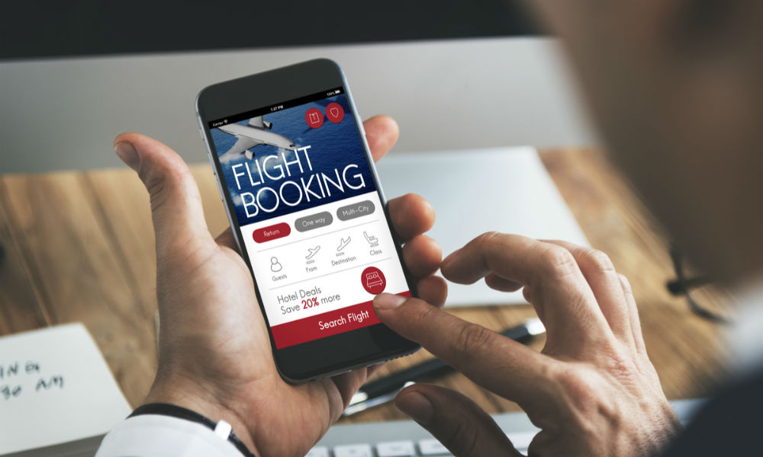


Problem
Solution
Application
Conclusion
Current Customer Experience Analysis Doesn’t Work Well.
Customer Experience Issues
Customer complaints ↑
Repurchase rate ↓
Good News
Bad News
Notes:
However, Sunrise recently…
It doesn’t work, because…

Slide 3
Problem
Solution
Application
Conclusion
Differentiating Customers and Their Needs is the Key.
1. Segment customers
For now
2. Examine the satisfaction rate of important needs
For the future
3. Predict satisfaction, and repeat step 2

Slide 4
Let’s dive in the Sunrise Airline Case…
Notes:
Now you understand the logic of the solution, let’s take the solution structure and dive in the … to see what we can find and if it really works.

Slide 5
Problem
Solution
Application
Conclusion
Data
Segmentation
Examination
Prediction
Data Overview
Sunrise’s Customer Experience Survey Data
3000 observations
23 variables
6 Customer-related: demographics + flight
16 Ratings: different factors that affect CX, e.g. delay, food & drink, entertainment...
1 Response: satisfied / dissatisfied

Slide 6







Problem
Solution
Application
Conclusion
Data
Segmentation
Examination
Prediction
Features and Needs of 7 Segments by Clustering and Shap
Segment 1
Inflight entertainment
Segment 2
Ease of online booking
Segment 3
Seat comfort
Segment 4
Inflight entertainment
Segment 5
Seat comfort
Segment 6
Ease of online booking
Segment 7
Seat comfort

Slide 7
Problem
Solution
Application
Conclusion
Data
Segmentation
Examination
Prediction
The Company Should Look into Segment 3 & 4
High-Value Customers – Seg 3
Most Dissatisfied Customers – Seg 4
(29% satisfaction)
Features
- 39 year-old
- Business travel
- Business class
- 3300 miles
Needs
1. Seat comfort
2. Inflight entertainment
3. On board service
Features
- 54 year-old
- Personal travel
- Economy class
- 2000 miles
Needs
1. Inflight entertainment
2. Seat comfort
3. Ease of online booking

Slide 8
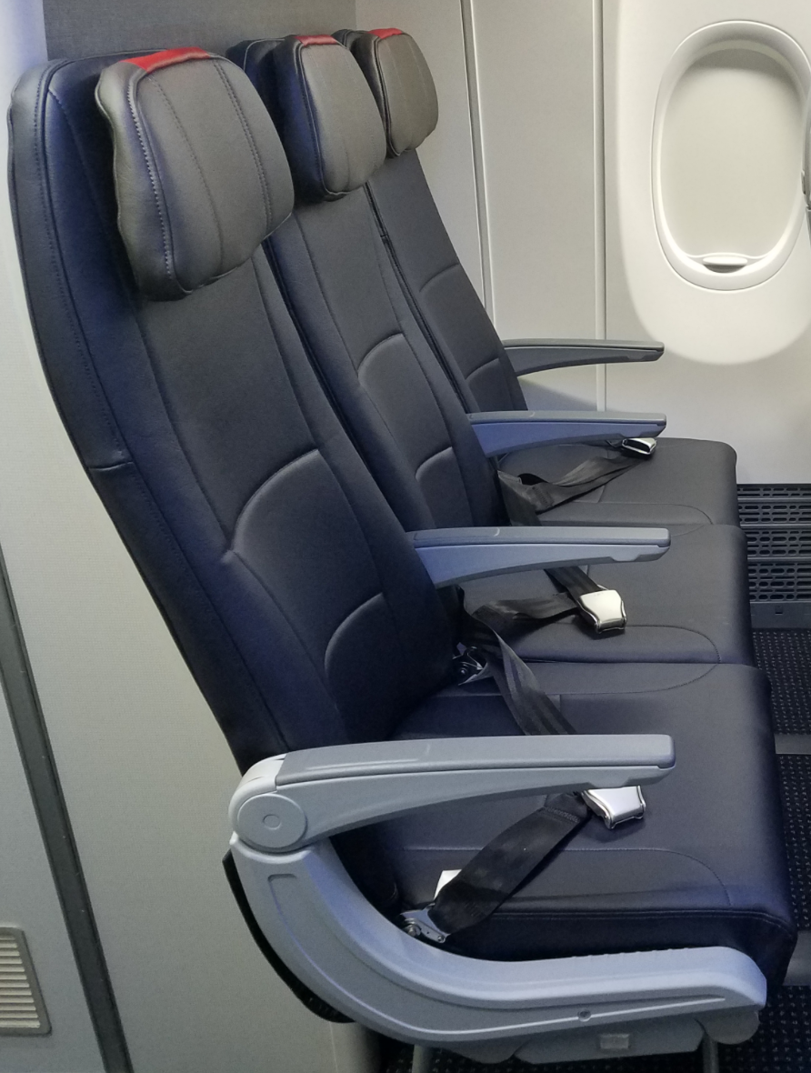
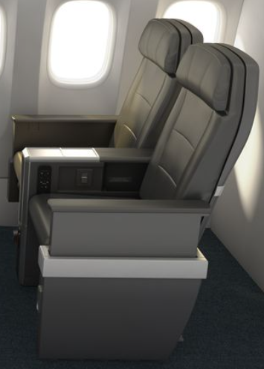
Problem
Solution
Application
Conclusion
Data
Segmentation
Examination
Prediction
Sunrise Airline Really Needs to Improve…
For Most Dissatisfied Customers
For High-Value Customers

Slide 9
Problem
Solution
Application
Conclusion
Data
Segmentation
Examination
Prediction
Prediction Model Helps to Improve Customer Experience.
What:
Satisfaction: satisfied / dissatisfied
Why:
for potential customers
2) for existing customers

Slide 10
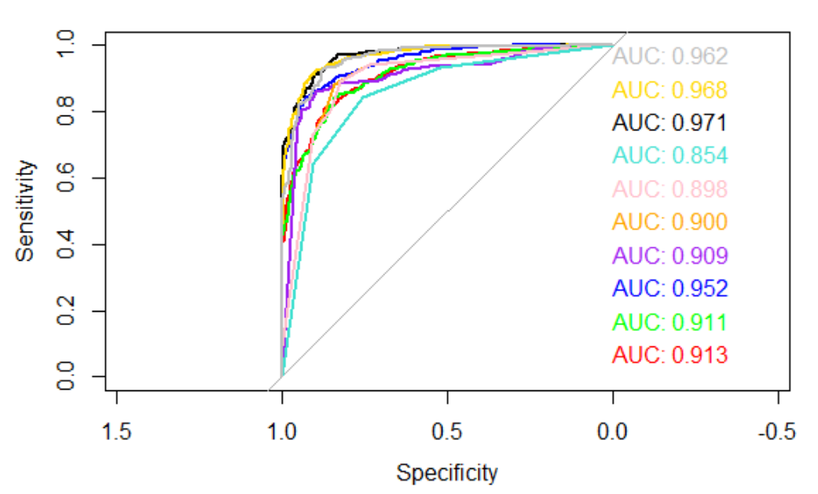
Problem
Solution
Application
Conclusion
Data
Segmentation
Examination
Prediction
Tuned Random Forest is the Best Model in this Case.
1. Trained 10 models
(logistic, neural networks, tree, rf, XGBoost…)
2. Compared AUCs
3. Select the best model
AUC of Tuned Random Forest Model

Slide 11
Problem
Solution
Application
Conclusion
Conclusion
1. Segment the customers
2. Examine if we satisfied the needs of important segments
3. Be proactive: predict satisfaction, and repeat 2nd analysis

